Slide 1
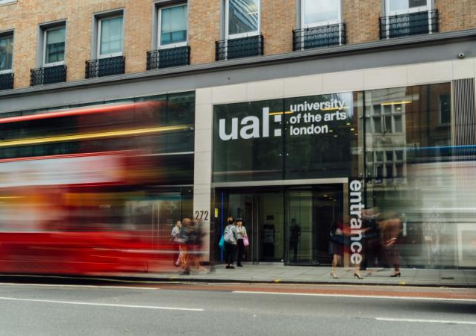

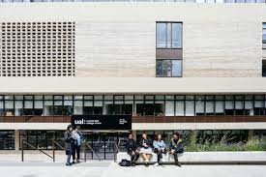
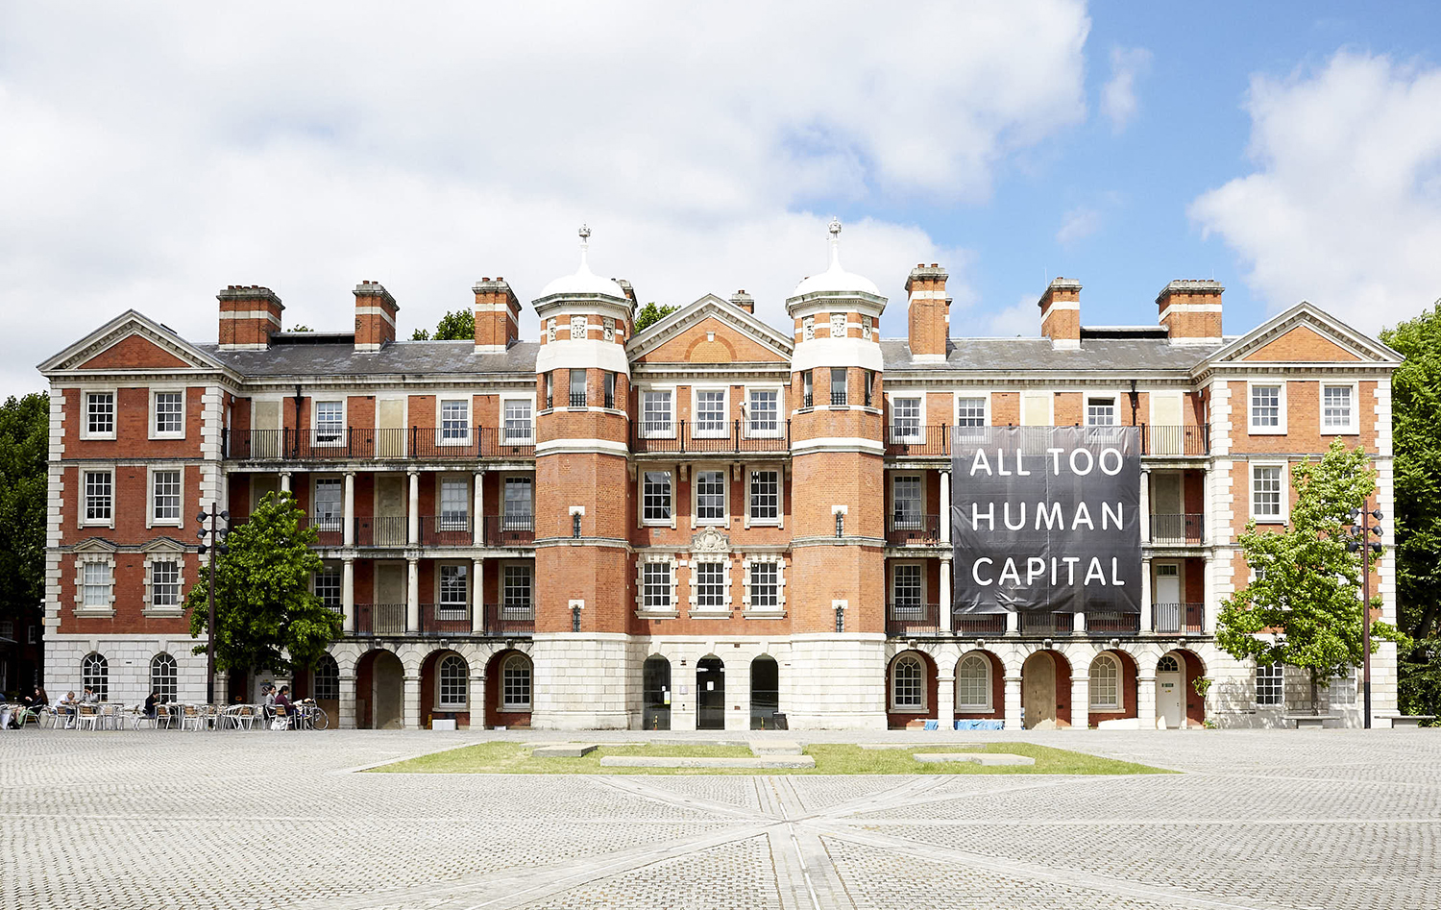
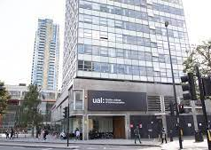
Jo McVey
Language Development Tutor
Teach at all colleges, currently based mainly at Camberwell College of Art.
Develop academic English language and literary skills
MA Education Culture Language and Identity
Background in Graphic Design
Notes:
Language Development Tutors aim to develop and improve English academic language and literacy for both undergraduate and postgraduate international students. Classes are weekly and provided as support classes negotiated with course leaders and year leads. The cohort who tend to have priority are Foundation program students, Year 1 and MA students following on from this Year 2 and 3 students receive support based on further negotiations with course teams. As such students can choose to attend, classes are not always timetabled or added to Moodle pages and other course information so this can be a challenge. As tutors we are keen to facilitate communication with those running courses to enable better engagement. Many of s also HPL staff.

Slide 2
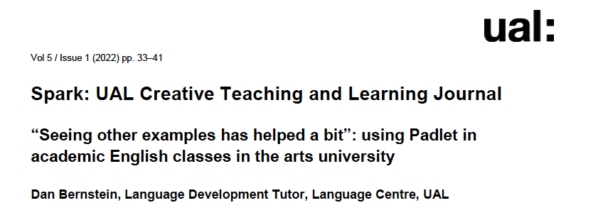
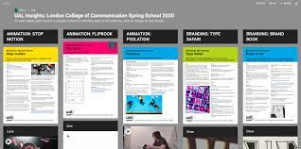
Spark Journal
The article looks at using Padlet the interactive ‘notice board style’ application for online classes.
The research examines how academic English language tutors can use this new creative opportunity provided by moving to online teaching during the Pandemic.
Notes:
My chosen article by my colleague Dan Bernstein

Slide 3

Examples used
1. Choose an image from a selection, this related to a discussion on meaning and representation linked to the student brief.
2. Identity and Culture - Students work in groups to decide on guidelines for staff and students to interact successfully cross-culturally.
3. Key themes from a course work brief: Thinking approaches, making methods, creative attributes.
4. Essay plans/drafts
Image source: www.indigenousgoddessgang.com
Notes:
Common examples of class content – as LD tutors we use unit briefs adapting content o develop academic English language and literacy skills

Slide 4

Reflections
“Overall, Padlet offers a range of activities and interactions. The ease of sharing and the visibility of the contributions is a major strength. Being able to access each other’s contributions and the teacher’s feedback quickly and easily can provide students with a richness of stimulus and inspiration.” (Bernstein, 2022, p. 30)
“The fact that the Padlet board remains accessible outside class time is greatly beneficial. It is almost unheard of for a language class at the university to have a permanent space where classwork can be displayed.” (Bernstein, 2022, p. 30)
Notes:
Responses given to each example showed that interaction between student and teacher opened up a dialogue that may in fact not be so present face to face.
Students when asked questions responded to help the tutor understand their meaning. This can often be a barrier to communication face to face when students are not comfortable verbally expressing themselves. So, using Padlet allows for an easier exchange.
In particular student's who when asked to collaborate in a groups the output as a collective piece of work further allows for expression both creatively and with language.

Slide 5
Conclusions
Padlet DOES
…use as close to real time as possible
…allows 'thinking time' for students
…gives teachers the chance to respond individually
…is accessible outside the classroom as Language Development classes do not have a permanent physical location (classroom) for students to access.
…gives a permanent place for students to access class content.
Padlet DOESN’T
…replicate the subtleties of interaction f2f
…is not for everyone as an unnatural way to communicate for some
…can mean some students are excluded if they are uncomfortable or choose not to add to the Padlet.
Notes:
Discussion points? How useful is Padlet? What are your experiences using Padlet? If you have not used it do you think you would?

Slide 6
Reference
Bernstein, D. (2022) ‘"Seeing other examples has helped a bit”: using Padlet in academic English classes in the arts university.’ Spark: UAL Creative Teaching and Learning Journal. Vol 5, Issue 1, pp 33-41.

